Slide 1
McGill MOOC sports medicine
Circus and Physical literacy
Patrice Aubertin
SSHRC Industrial Research Chair fo Colleges in Circus Arts
Director of Research and Teachers training programmes

Slide 2
PART 1
Circus and Physical literacy

Slide 3
The School

Slide 4
PART 2
Circus and Physical literacy

Slide 5
Preparing for a physically active life sports/performance arts/vocation
WE SHOULD BE ABLE TO:
Demonstrate a wide variety of basic human movements, fundamental movement skills and fundamental sports skills.
In different physical environments (on the ground, both indoor and outdoor; in the air; in and on water; on snow and ice).
Develop the motivation and ability to understand, communicate, apply and analyze different forms of movement.
Make engaging choices.
h
Adapted from canadian sport for life

Slide 6
Preparing for a physically active life sports/performance arts/vocation
DOING (time on task…)
USING (…variability, equipment and environment…)
INTERACTING (…increasing ownership and creativity)
True for everybody AND a must for children

Slide 7
What percentage of people are active enough?
Age | Males | X | Females
6–11 | 48.9% | 41.8 | 34.7%
12–15 | 11.9% | 7.65 | 3.4%
16–19 | 10% | 7.7 | 5.4%
20–59 | 3.8% | 3.5 | 3.2%
60+ | 2.5% | 2.4 | 2.3%
-16% drop in PA 2008 to 2011
(Manitoba accelerometer)
YET, 52% of people self-report they are active enough! 10.9X over-estimate!
Notes:
Activity levels drop precipitously with the onset of puberty and stay low through adulthood. Even in manitoba where there is mandatory K to 12 phys ed with mostly specialist teachers and a high number of PE classes per week we have observed a substantial drop in activity over a few short years! Self report of physical activity is just a perception- there is a substantial mismatch between what we perceive and what happens in reality.

Slide 8
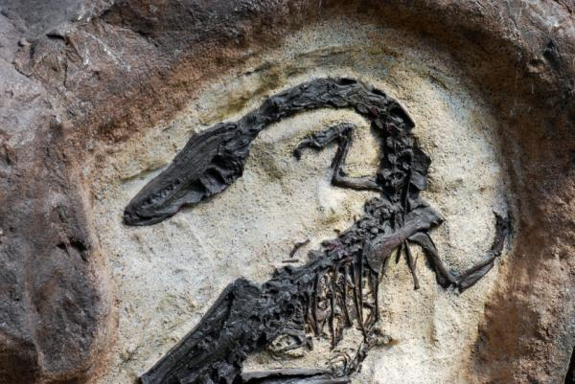
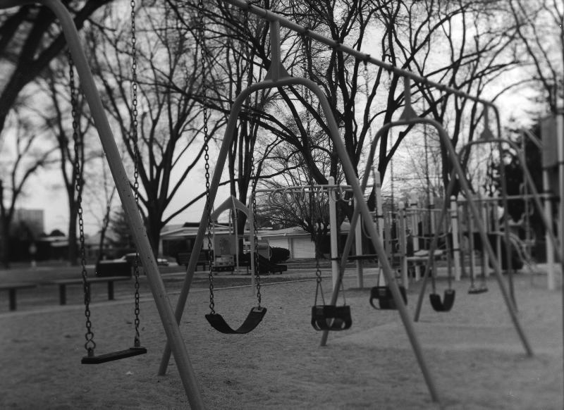
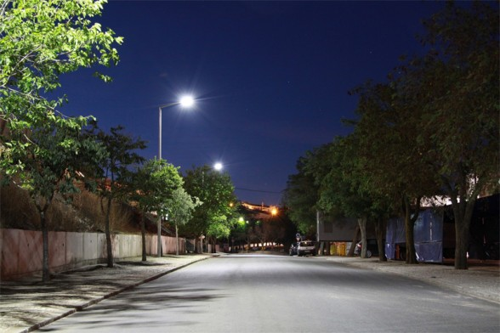
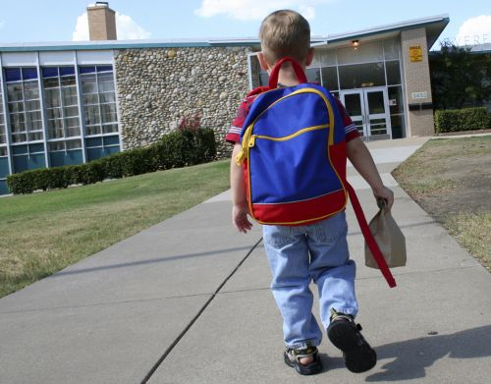
The just in time syndrome…
Unstructured play is EXTINCT! Gone the way of the dinosaur.
Playgrounds empty!
“Come home when the street lights come on!” never to be heard again!
“Walk to School” has been eradicated in ONE generation. 2000 steps a day gone.
Notes:
Low structured or no structured play is almost absent in our children, due to liability concerns, diversion toward structured activities, and anti-bullying. As a result we still make (spend funds) on playgrounds and structures that often stand empty. Our urban and sub-urban children are being driven to school more often nowadays, and unwarranted fears of safety are often heralded as the reason. Plus our JUST IN TIME mentalities make us always rushing from one venue to the next – so the car becomes the option of choice instead of two feet. Finally we tend to provide far too much oversight over our children, helicopter and bubble parenting. We don’t really need to see every game or activity, especially if we are jst sitting around watching – not good role modeling!!

Slide 9
PART 3
Circus and Physical literacy

Slide 10
Littératie physique
“Physical literacy can be described as the motivation, confidence, physical competence, knowledge and understanding to value and take responsibility for engagement in physical activities for life.”
(Whitehead, 2014)

Slide 11
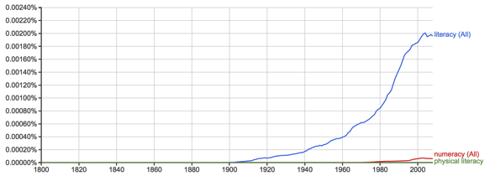
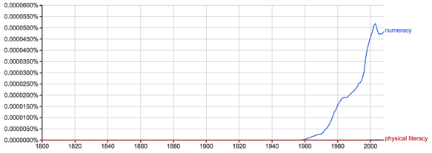
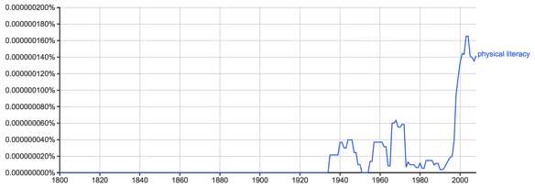
Literacy Campaigns: Word Usage 1800-2008
Literacy
We must prepare for physical literacy as well as for mental literacy. A physically fit America becomes more necessary with modern mechanical inventions. 1930
1910
Numeracy
Educators now say that the public schools must train for physical literacy, as well as mental literacy. There is much physical illiteracy in America. 1935
1960
Games, climbing, walking, dancing and manual occupations such as carpentry, building and so on, all conduce to physical literacy: that is to a disciplined command over the body. The same is true of literacy of the year. 1937
Physical Literacy
1930
1992

Slide 12
Notes:
Many groups have adopted this term and integrated it into their operations.

Slide 13
“Skill Based Literacies”
Literacy
ABC
Words
Sentences
Numeracy
123
Fractions
Equations
Music
Do-re-mi
Scale
Score
Physical Literacy
Movement vocabulary
Sequences
Tasks

Slide 14
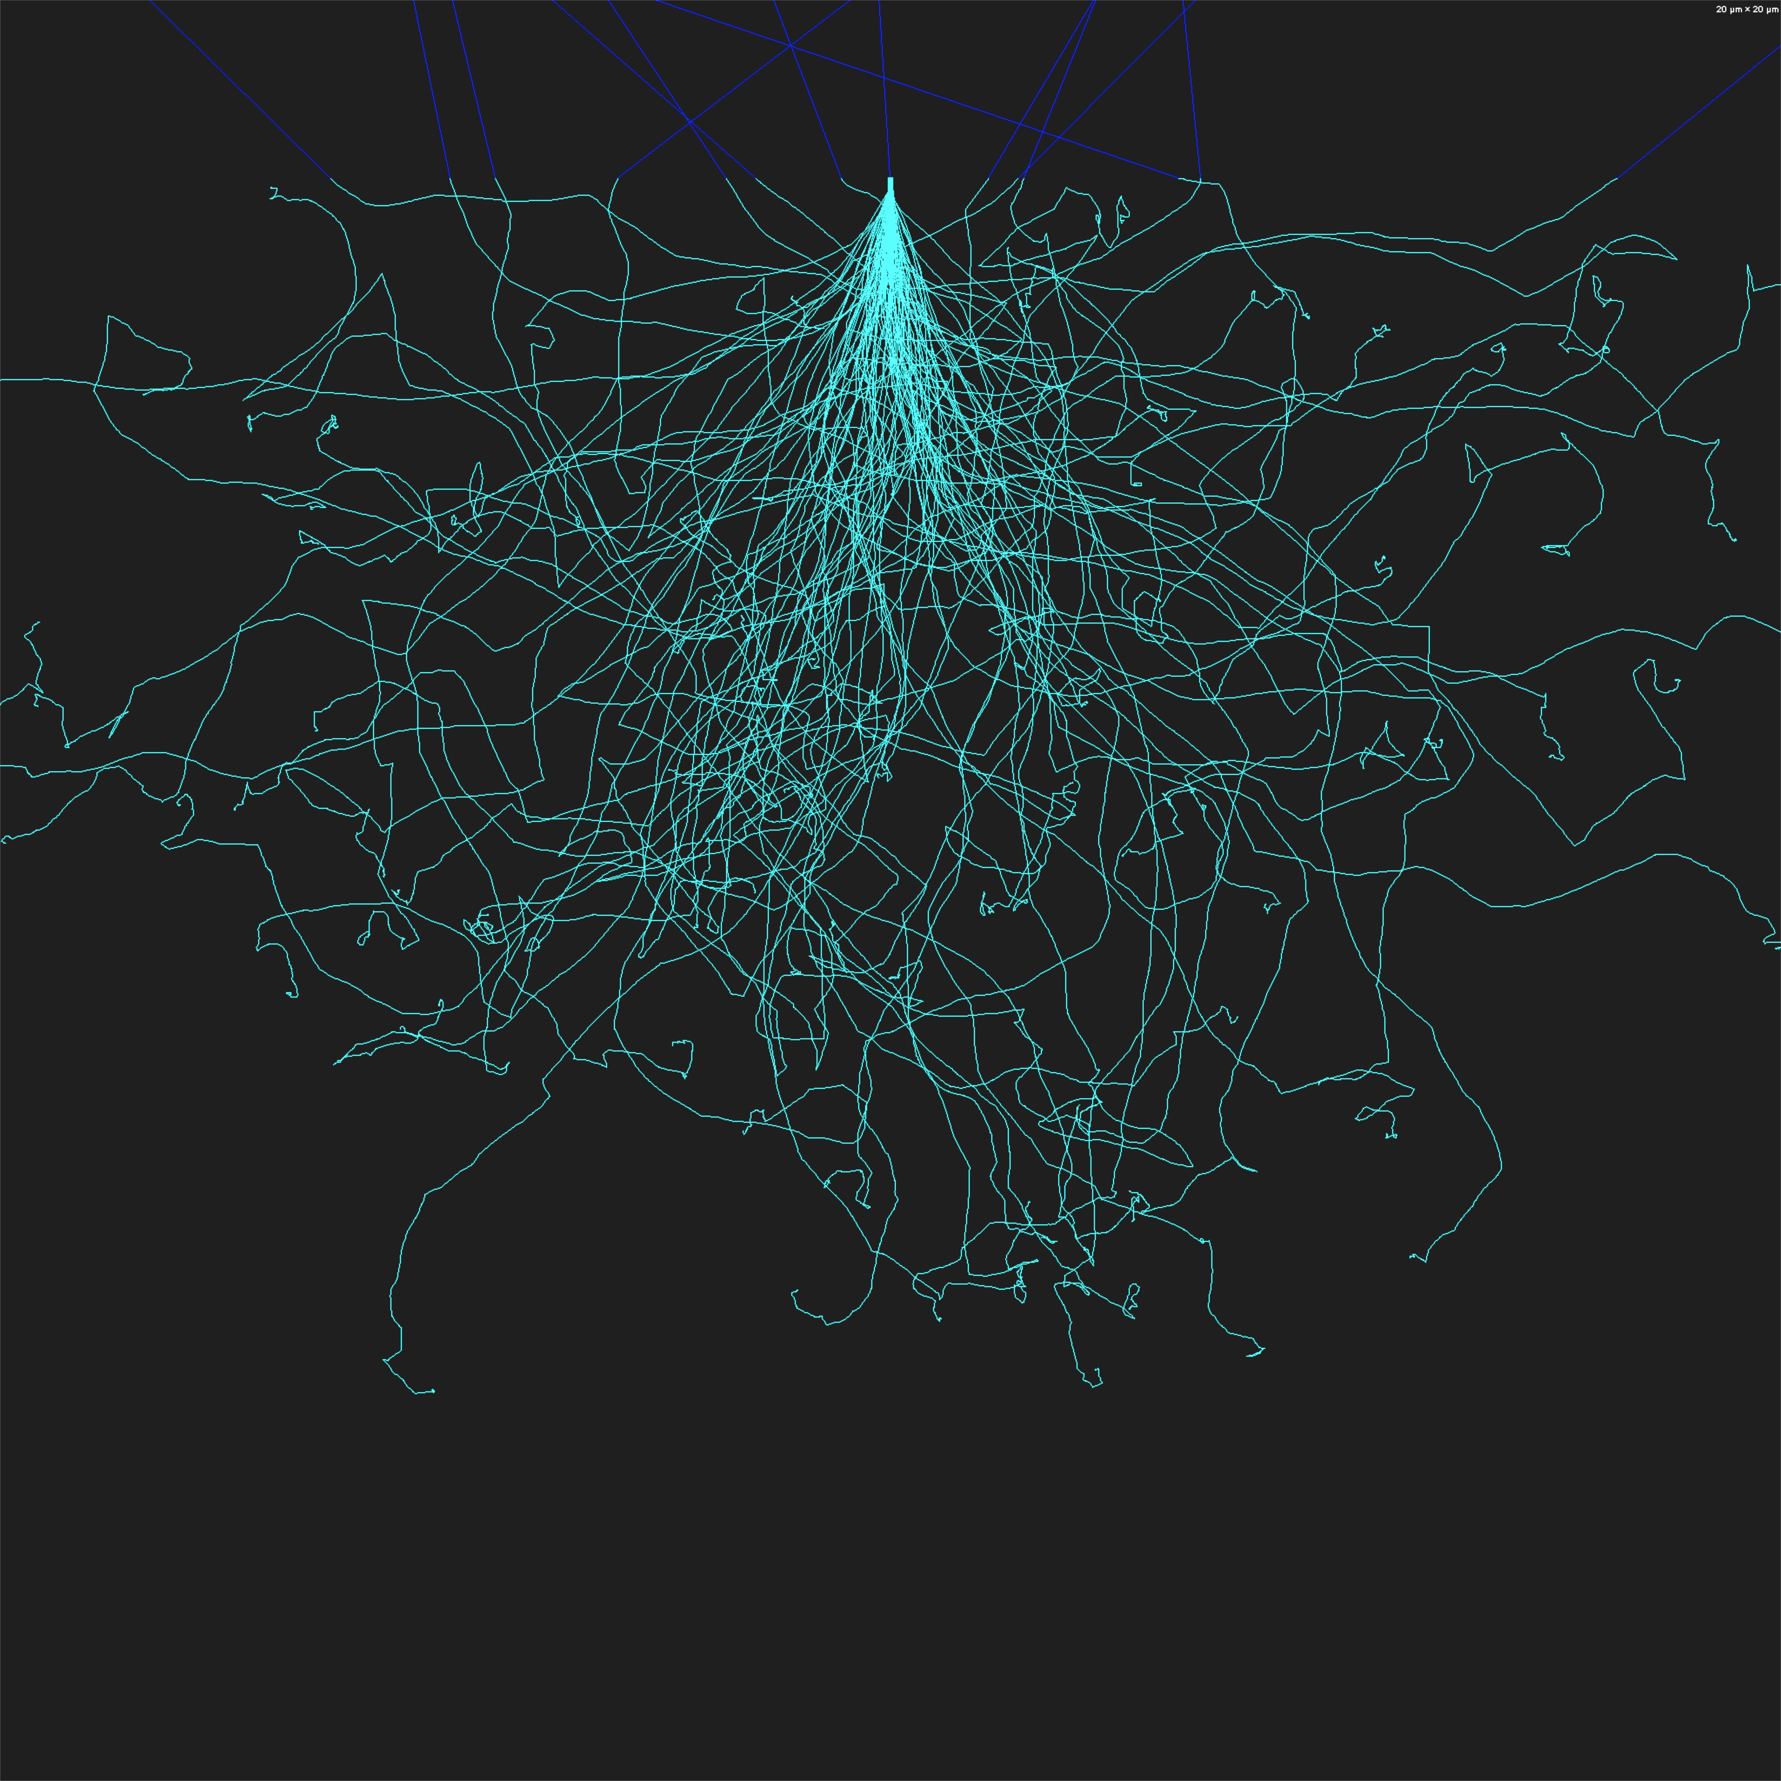
The Physical Literacy Journey
Equipping for the Journey
&
Managing Trajectories
Birth
Birth

Slide 15
Physical Literacy Across the Lifespan & Sectors
Leisure: Recreation & Sport
Performance Excellence & Participation
Performance Arts
Circus, dance
Vocational
Firefighter, armed services, dry waller, iron worker, underwater welder, any vocation with physicality
Activities of Daily Living
Garden, paint, hammer, walk on slippery surfaces, etc
Injury Prevention
Lift, carry, transfer, lower – back injury – WCB
Falls, stumble recovery, landing – fracture
ACL: Female to Male ratio is 6:1, physical literacy related!

Slide 16
The Cycle
Confidence
Motivation
Competence

Slide 17
Quality
Physical Literacy
Experience
Social
Psychological
Physiological
Biomechanics
Performance
Nutrition
Outcome
Eudemonia “flourishing”
Meaningful Participation
Recreation
Sport
Vocation
Performance Arts
At School
Physical Education
Rehabilitation
Medicine
Physical and Mental Health
Justice
Employment
…

Slide 18
PART 4
Circus and Physical literacy

Slide 19
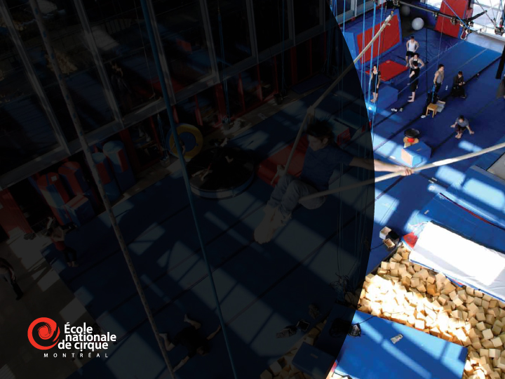
What a Physical Literacy enriched environment could look like…
Through the Circus arts lens…
There are many other lenses….

Slide 20
Skill domains comprising circus arts for educational purposes
Davis 2005
Juggling and manipulatives
bimanual coordination/visuomotor
Acrobatics
Balance
vestibular/postural/proprioceptive
Aerials
Character work /physical theater/ clowning

Slide 21
This is where we could walk around and watch our students…..

Slide 22
Circus arts and Physical literacy
Climb
We do…
Land
Rotate
Swing
Jump
Fall
Run
Balance
Catch
Throw

Slide 23
Circus arts and Physical Literacy
…..With creativity!
In a wide array of situations AND combinations
SENSE OF SELF AND SELF EXPRESSION!!!!

Slide 24
Circus arts and Physical Literacy
With activities that are Inclusive!!
Something for everyone! Even the most marginal ones.
in communication with other
DOING USING INTERACTING

Slide 25
Circus arts and Physical Literacy
Mapping circus arts onto six essential elements of childhood
Constructive physical (and artistic) risk
Aspiration
Trust
Fun
Self-individualisation
Hard work
Bolton (2004)

Slide 26
PART 5
Circus and Physical literacy

Slide 27
Becoming a Physical Literacy Champion!
Through promotion
Through program DELIVERY!!!
Increase vocabulary repertoire
Maximal use of various environments
Creative exploitation of the above
Through evidence based research\evaluation

Slide 28
Becoming a Physical Literacy Champion!
Our Physical Literacy study on the impact of circus arts practice
Does circus instruction in school provide benefits to children in comparison to matched school children, and age matched normative data?
Quasi-experimental, natural experiment with control
Grades 4 and 5
6 Schools (211 kids)
3 with circus (within PE, not up and above) and 3 control, matched SES
Two measurements (Jan/Feb and May/June of 2014)

Slide 29
Instruments
PLAY FUN – objective assessment of motor competence, movement vocabulary, confidence, comprehension
PLAY Coach– coach/PE/PT/AT assessment of a child
PLAY Parent – parental assessment of a child
PLAY Self- child’s self assessment
PLAY Inventory- inventory of activities- participation
Physicalliteracy.ca
Notes:
Only the PLAY Fun tool requires special training. These tools are designed to align with the PHE Canada Passport for Life tool described next.

Slide 30
The Physical Literacy Lens
PL Assessment is more than just physical; PL Assessment includes
Physical
Environments
Diversity
Competence
Psychological
Cognitive
Self-efficacy
Worry
Confidence
etc
Social
Participation
Objective Assessment
Motor Competence
Confidence
Comprehension of terms
Quantity of Acquired Movement Vocabulary
Perceptions
Self
Parent
PE/Coach/instructor
Participation
Type
Environment

Slide 31
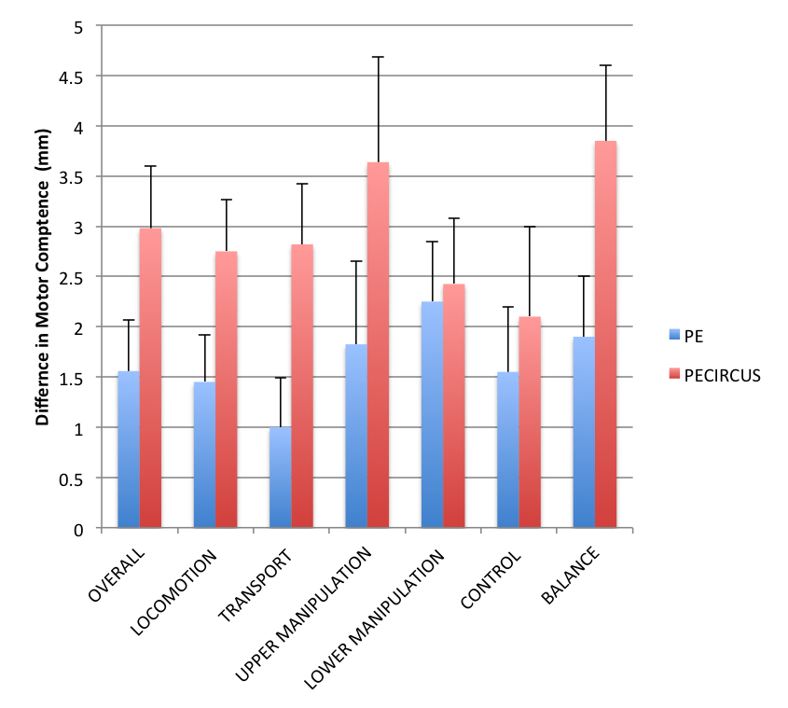
Motor Competence
✪
✪
✪
✪
✪

Slide 32
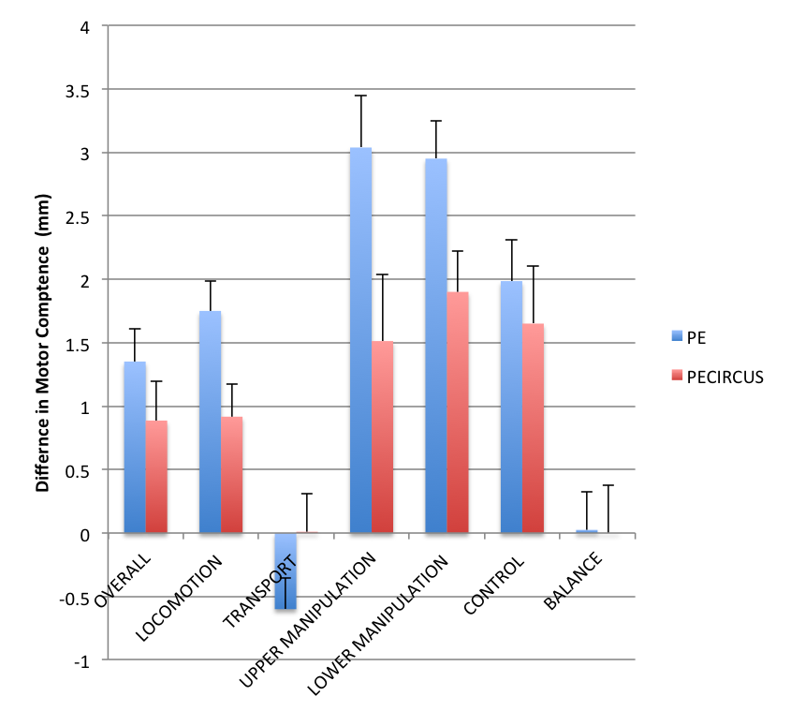
Gender Gap
✪
✪
✪
✪ - skipping

Slide 33
Findings/Play Self & Coach
Children in circus (Self reported)
Feel they are talented!
Are more eager and motivated to participate, especially females.
Accept the importance of learning new movements
Feel they comprehend movement terminology.
Coaches/teachers see children in circus as having higher
Confidence, motivation, comprehension, and diverse movements

